Slide 1


Body Cavity and anatomy plane
Dr. Mahdi H. Hammadi
PhD Sc. Clinical Physiology

Slide 2
Human Anatomy:
Practical:
Week | Subject
1 | Practical on Terminology of the body
2 | Practical on Body Regions and major body cavities
3 | Practical on Epithelial Tissue
4 +5 | Practical on Connective Tissue
6 | Practical on the Skull
7 | Practical on vertebrae, Ribs and the sternum
8 | Practical on the pectoral girdles and superior appendages
9 | Practical on the Pelvic Girdle and inferior appendages
10 | Practical on nervous histology AND THE Anatomy of the spinal cord
11 | Practical on human Brain Anatomy
12 | Practical on the sheep Brain
13+14 | Practical on introduction to Skeletal Muscles
15 | Practical on Skeletal Muscles

Slide 3
Some important anatomical terms:
Superior (Cranial)
Closer to the head
Inferior (caudal)
Away from the head
Anterior (ventral)
Toward the front of the body
Posterior (dorsal)
Toward the back of the body
Medial
Toward the midline of the body
Lateral
Away from the midline of the body
Proximal
Closer to the trunk
Distal
Away from the trunk
Superficial

Slide 4
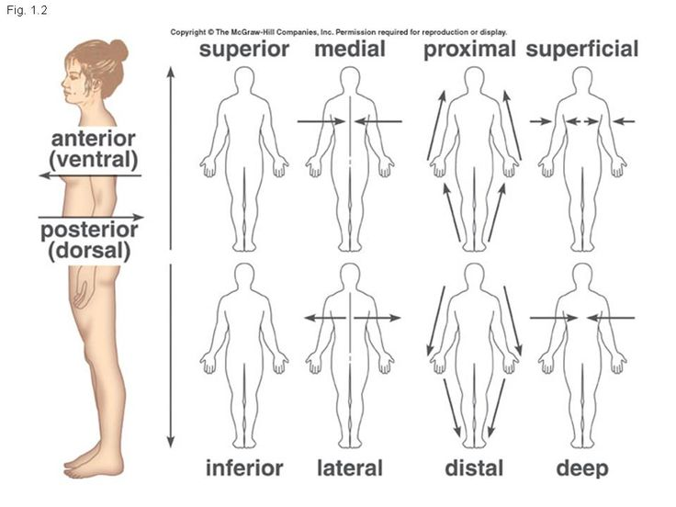

Slide 5
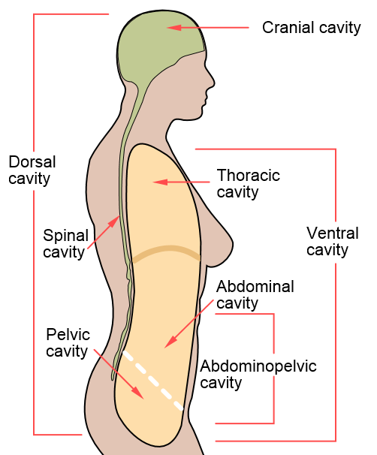

Slide 6
Anatomical Planes المستويات التشريحية:
1- Sagittal (median) plane المستوى المتوسط او السهمي
2- Frontal (Coronal) plane المستوى الاكلينيكي او التاجي
3- Transvers (Horizontal) plane المستوى الافقي او المستعرض

Slide 7
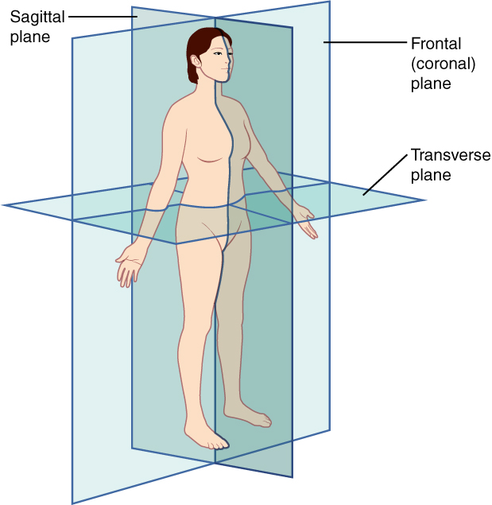

Slide 8
planes, referring to two-dimensional sections of the body.
The sagittal plane is the plane that divides the body or an organ vertically into right and left sides.
The frontal plane is the plane that divides the body or an organ into an anterior (front) portion and a posterior (rear) portion.
The transverse plane is the plane that divides the body or organ horizontally into upper and lower portions. Transverse planes produce images referred to as cross sections.

Slide 9
Body Organs and Tissues Terms:
Brain
Nerve
Spinal Cord
Cranium
Skull
Heart
Valve
Cardiac
Artery
Vene
Capillary

Slide 10
Spleen
Lung
Pulmonary
Femur
Ribs
Intestine
Colon
Bone
Kidney
Renal
Bronchia
Trachea

Slide 11
Epiglottis
Tongue
Esophagus
Tonsils
Vertebra
Muscle
Skeletal
Lymphoid

